Slide 1
NEWS RECOMMENDER SYSTEM
SUBMITTED TO -
MENTORED BY -
SUBMITTED BY -
SARAB ANAND
JASKARAN SINGH
VIJAY GARG
ARSHDEEP SINGH
GURLEEN KAUR
AAKRITI MITTAL

Slide 2
PROBLEM STATEMENT

Slide 3
PROBLEM
BOT 1
BOT 2
COLD START PROBLEM No User Data No Personalization
Generated user data
Personalized Recommendations

Slide 4
WORK FLOW – BOT1
Step 1
DATA COLLECTION
Data Collection - Web Scraping (thetribuneindia.com, timesindia.com)
Step 2
PRE - PROCESSING
Cleaning data Tokenization Removing stop words Forming vectors
Step 3
MAKING CLUSTERS
checking for different types of clustering K-Means Agglomerative
Step 4
RECOMMENDING ARTICLES
Randomly from clusters latest According to date From clusters According to rankings of Articles
Tools used – Scrapy, beautiful soup

Slide 5

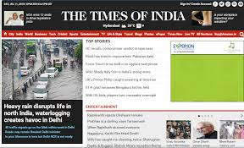
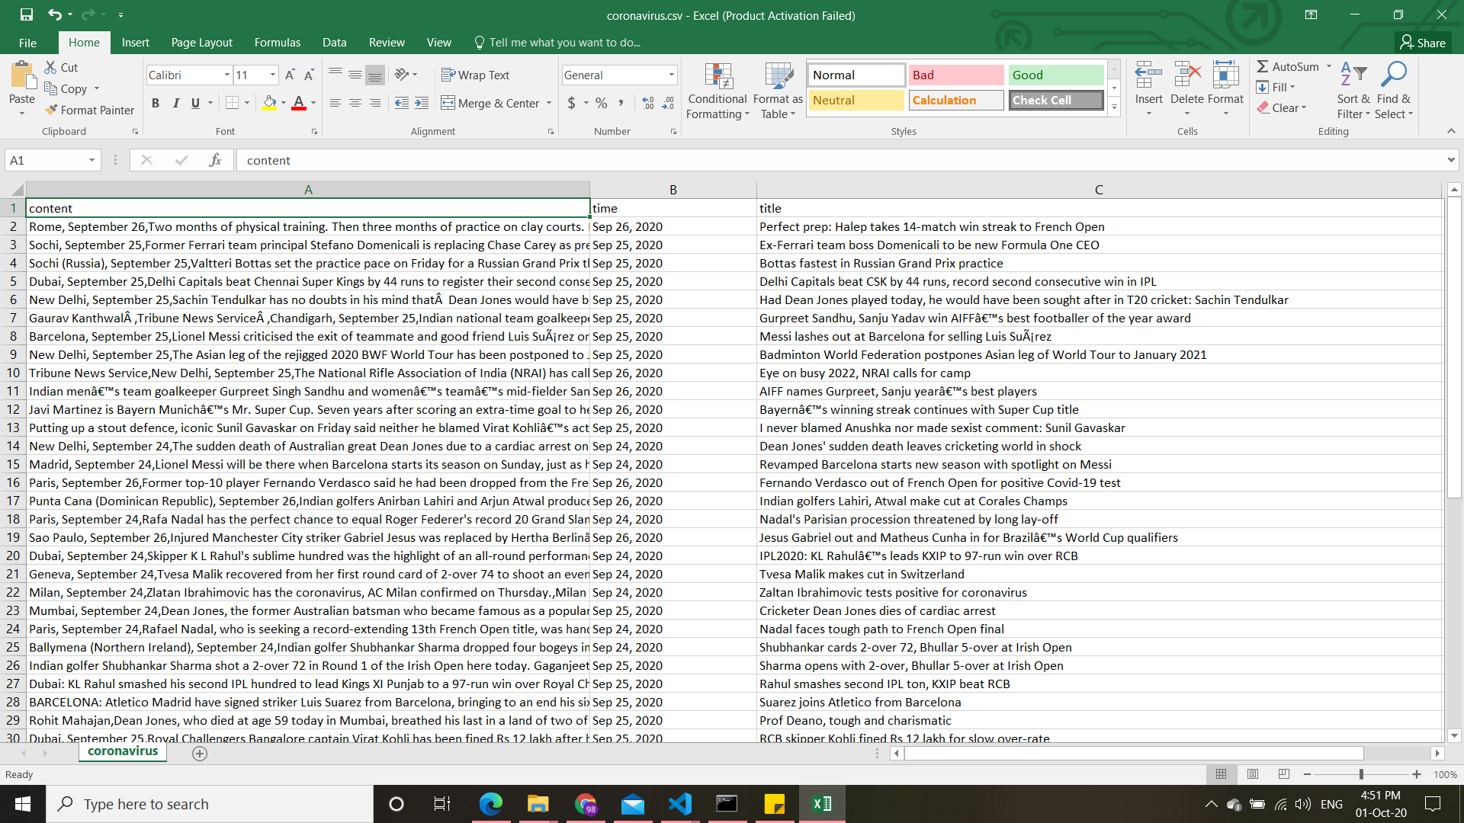
DATA COLLECTION
WEB SCRAPPING – Scrapped the data from two websites
Final Data
Tools used - SCRAPY, BEAAUTIFULL SOUP
https://www.tribuneindia.com/
https://timesofindia.indiatimes.com/

Slide 6
DATA PRE-PROCESSING
Removing words other than [a-z, A-z] with help of regular module
Removing stop words in the content using the NLTK library
Tokenize content
Forming vectors – BAG OF WORDS TFIDF WORD EMBEDDINGS
Notes:
Summarize your research in three to five points.

Slide 7
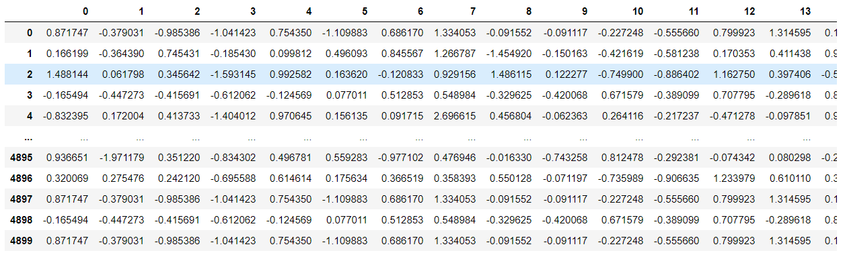
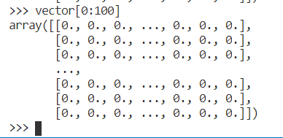
DATA PRE-PROCESSING
WORD2VEC vectors
TFIDF vectors

Slide 8
CLUSTERING
K-Means
Agglomerative

Slide 9
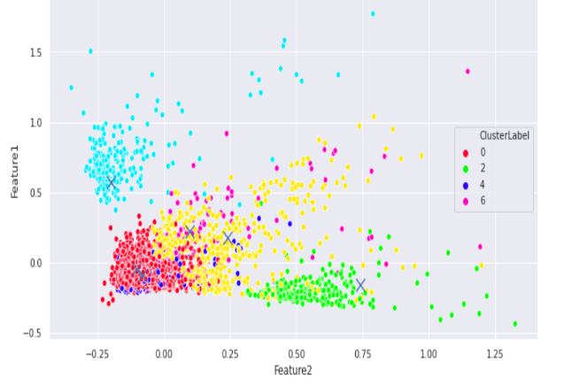
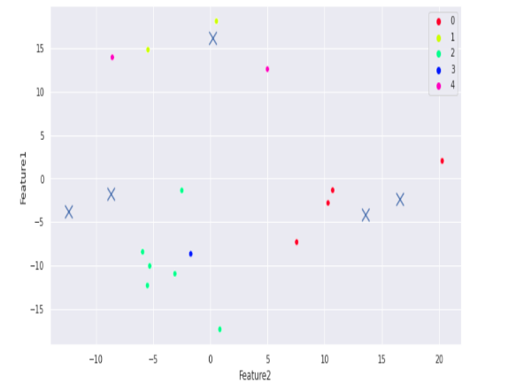
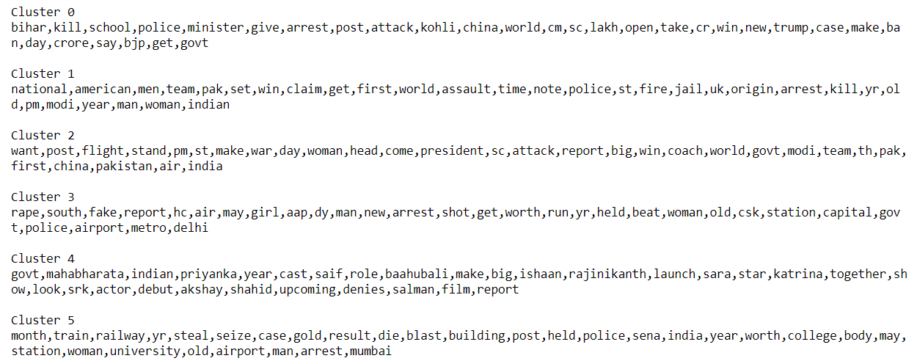
EVALUATION OF CLUSTERING
TOP WORDS FOR NAMING
TFIDF KMEANS
WORD2VEC K-MEANS
TFIDF AGGLOMERATIVE
WORD2VEC AGGLOMERATIVE

Slide 10
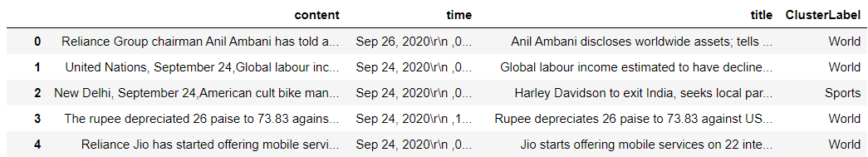
RECOMMENDING ARTICLES
RANDOMLLY FROM DIFFERENT CLUSTERS
LATEST ACCORDING TO DATE/TIME FROM DIFFERENT CLUSTERS
RECOMMENDING ACCORDING TO RANKING COLUMN

Slide 11
CONCLUSION BOT1

Slide 12
WORK FLOW – BOT2
Step 1
DATA GENERATION
INFORMATION ABOT DATA GENERATION
Step 2
COLLABORATIVE
about
Step 3
HYBRID
about

Slide 13
DATA GENERATION

Slide 14
CONTENT BASED

Slide 15
COLLABORATIVE APPROACH

Slide 16
HYBRID APPROACH

Slide 17
CONCLUSION
FINALLIZED THIS METHOD

